Slide 1
Vendor C-CDA to FHIR mapping review and alignment

Slide 2
PAMPI Gaps Filling - Medications

Slide 3

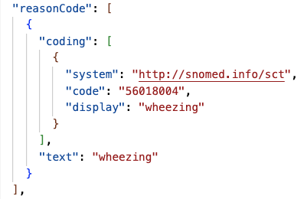
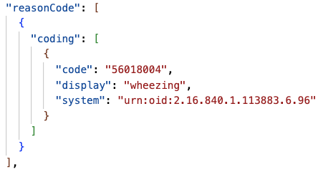
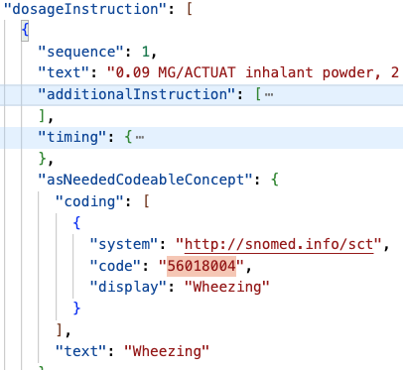
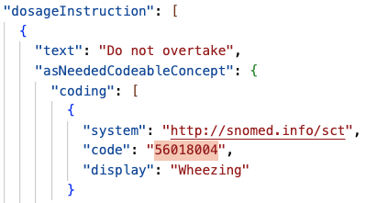
Sig
A
G
O
S
Indication
precondition

Slide 4
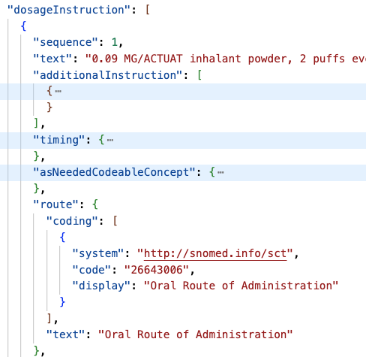
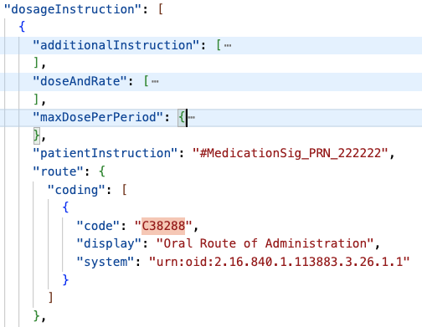
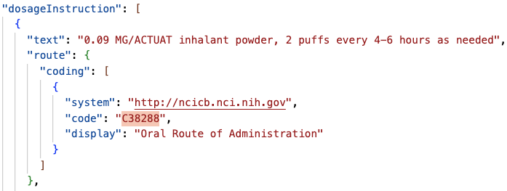
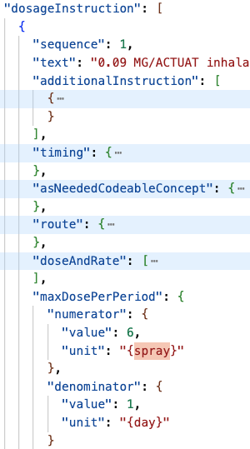
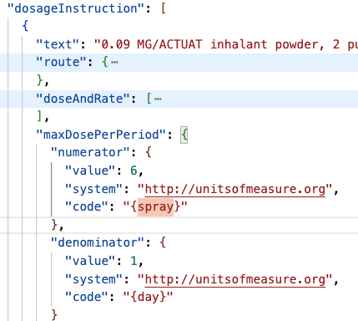
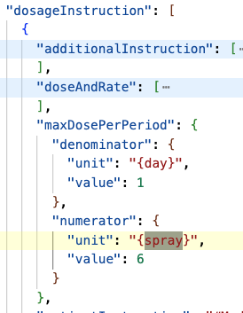
Route
G
O
S
get Smile’s system verify the URI
maxDoseQuantity
get all 4 attribute since it’s curly bracket

Slide 5
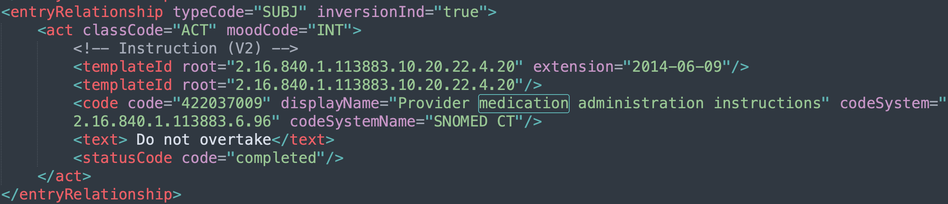
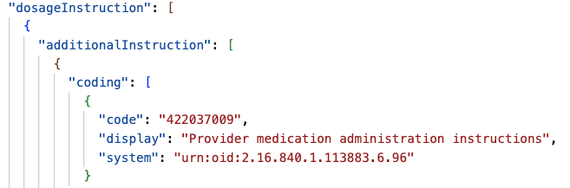
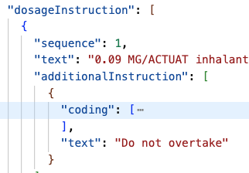


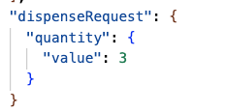
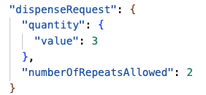
Instruction
A
G
M
O
S
Chun to change the example to be consistent with “do not overtake”; map the code to additionalInstruction, and text to patientInstruction
Supply (Dispense ER with an INT moodCode)
numberOfRepeat needs to be reduced by 1 when mapped to FHIR; only map when the dispense moodCode is INT as the meaning is different when the moodCode is EVN
Notes:
dispense: pharmacy hand over
administration: patient take the meds

Slide 6
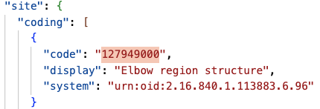
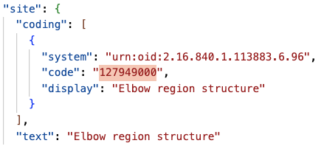
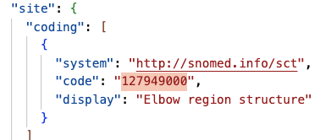
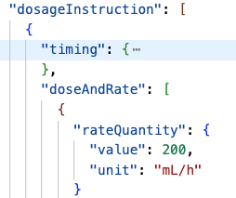
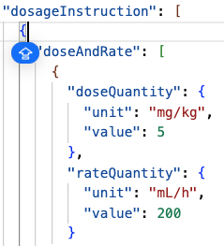
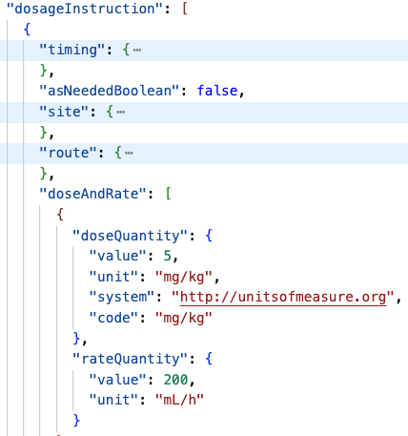
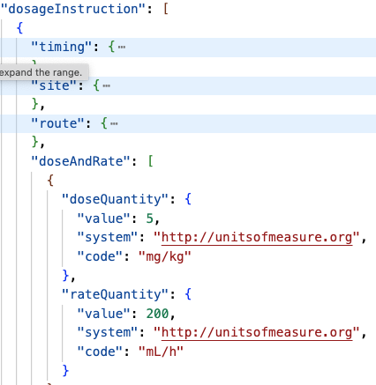
Site
A
G
M
O
S
Dose and Rate

Slide 7
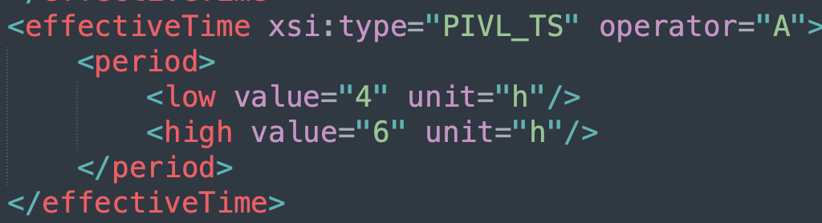
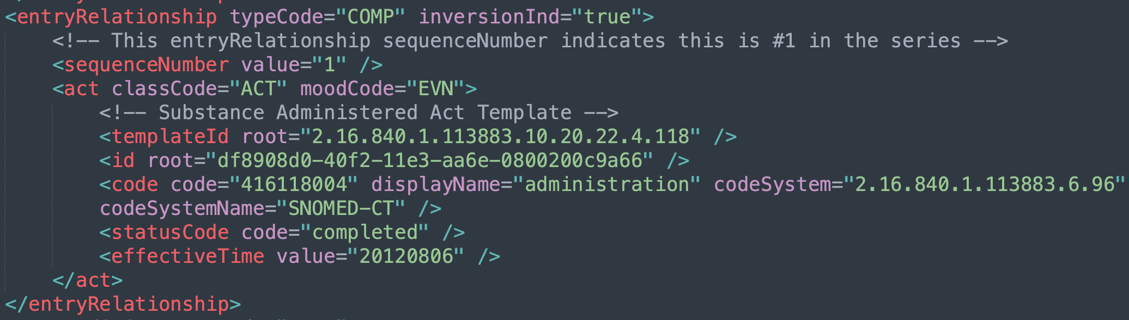
Attributes that no vendors have mapped - 1
The second timestamp
https://hl7.org/fhir/R4/datatypes.html#Timing
map to period, periodMax, periodUnit
administrationUnitCode – Ken /Benjamin
Substance Administered Act

Slide 8
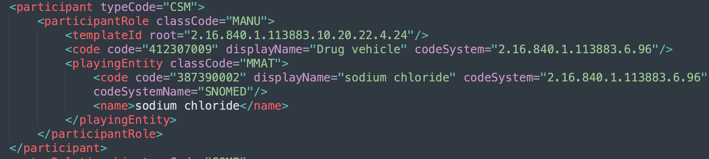
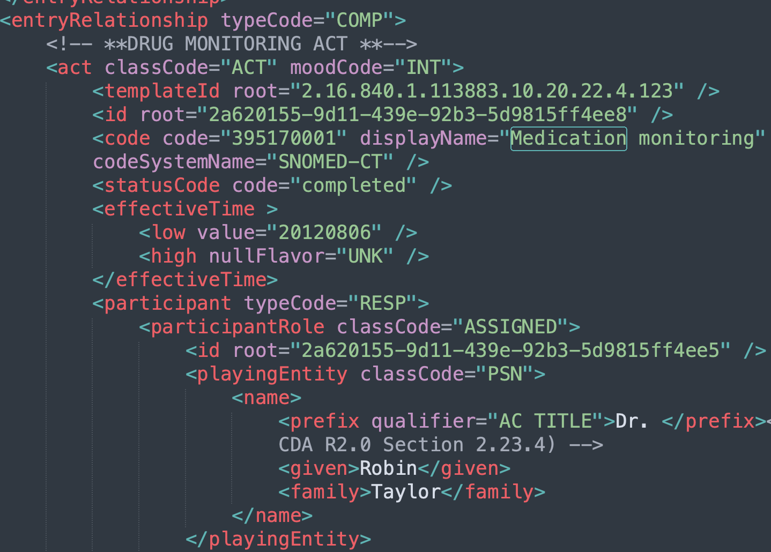
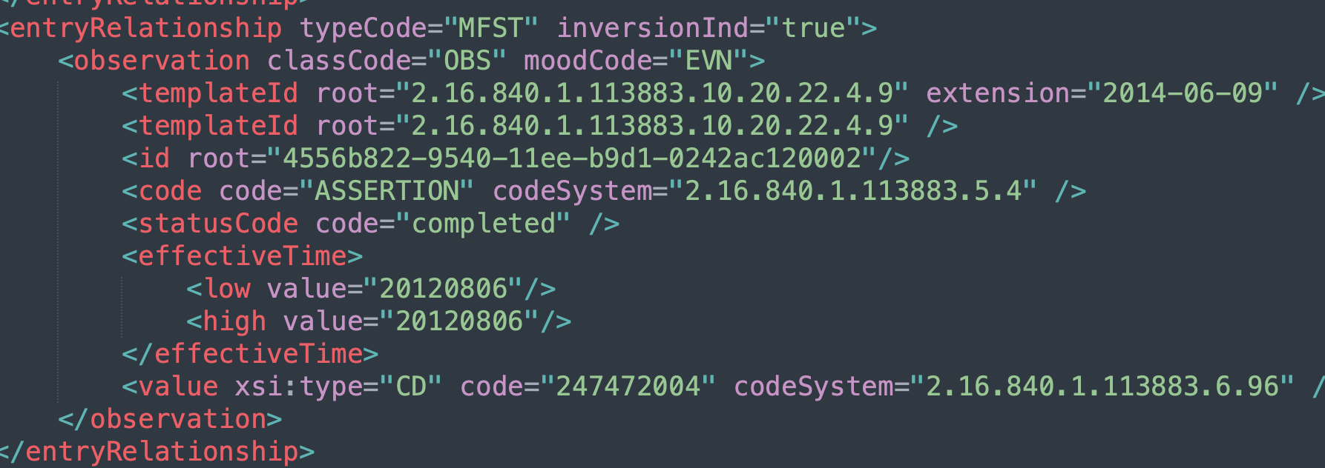
Attributes that no vendors have mapped - 2
Inconsistency between
Natalee to create a Jira to clarify
Drug Vehicle
Drug monitoring
Reaction

